Slide 1


ONS DataSet
Silvi George
Notes:
Hi, My name is Silvi George. Today I will be analysing a dataset representing the drug misuse in England and Wales up to 2023.

Slide 2
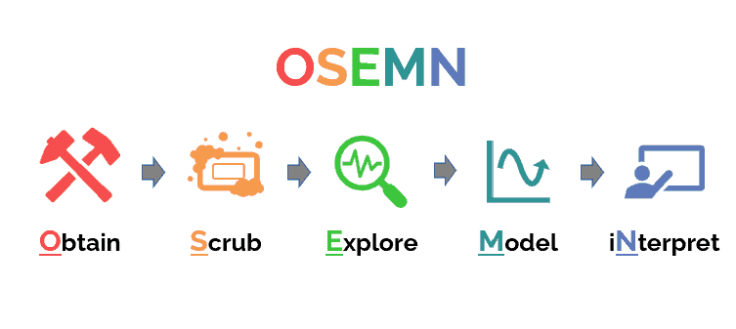

Notes:
I will use the OSEMN framework , that is Obtain, Scrub, Explore, Model and Interpret to analyse and visualise my data.

Slide 3
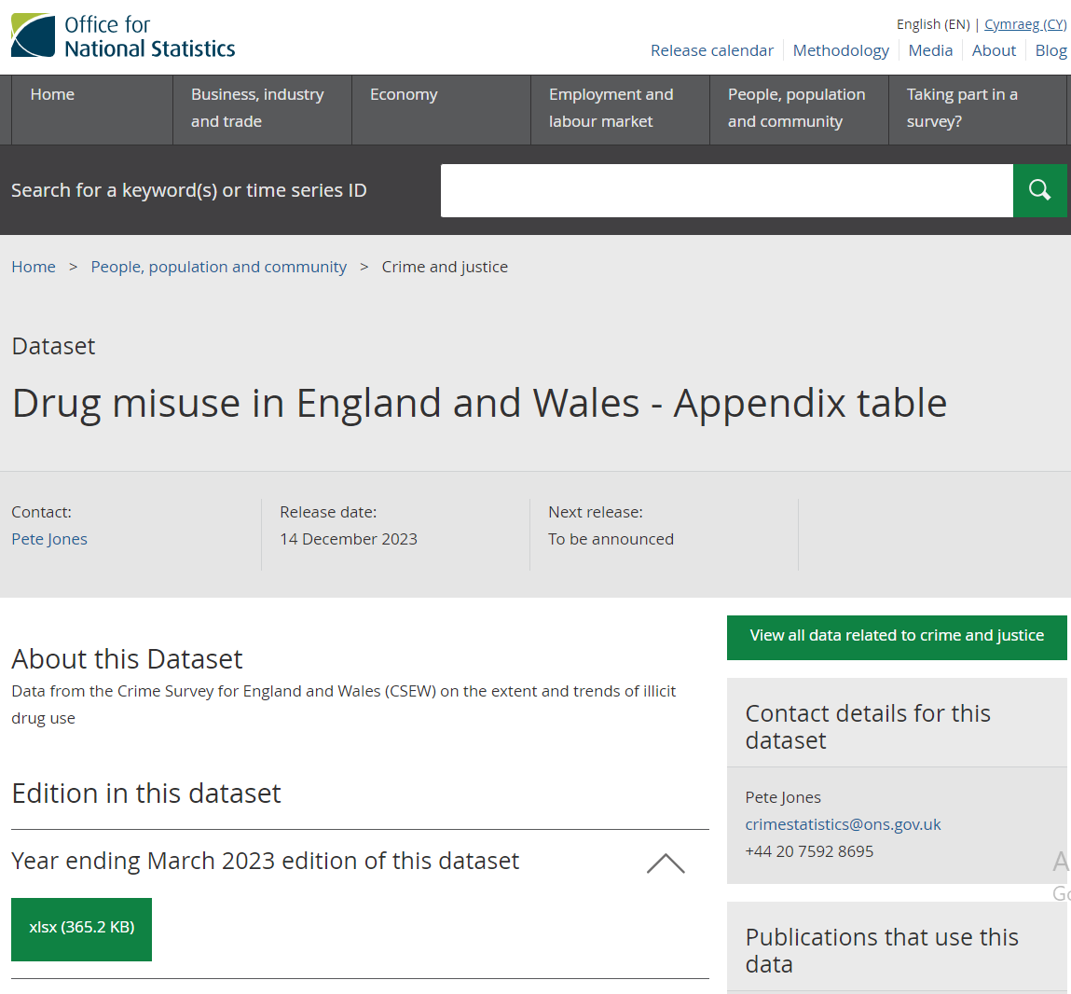

My Data Set
Notes:
To obtain my data, I downloaded the Excel file from the Office for National Statistics website. The most recent data set available is for the year ending March 2023.

Slide 4
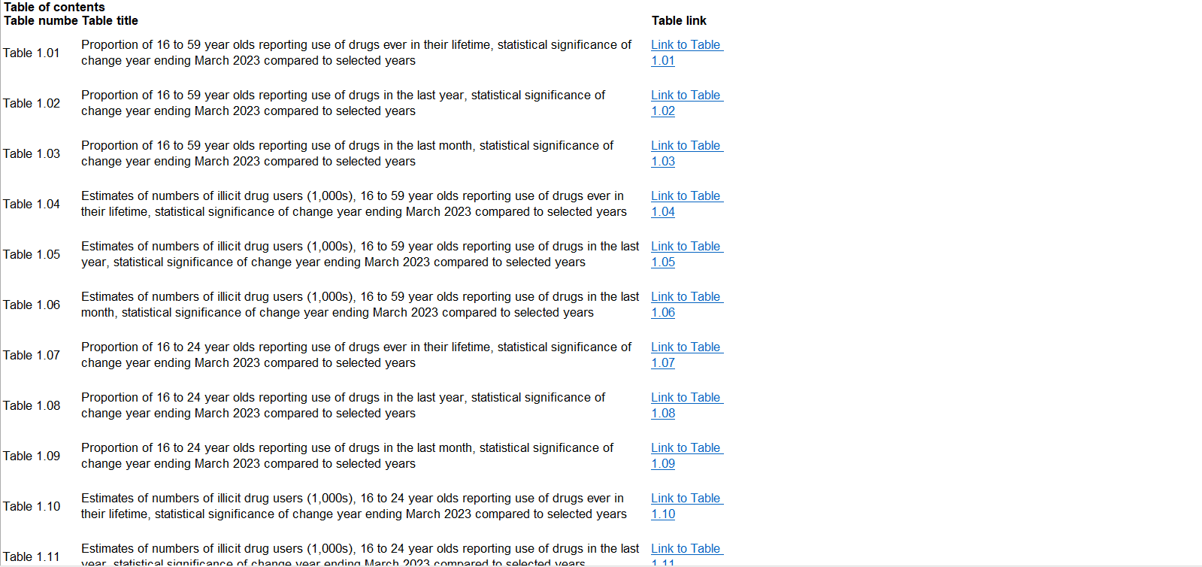

Notes:
After downloading and reviewing the dataset, I categorised and simplified the contents for a better understanding.

Slide 5
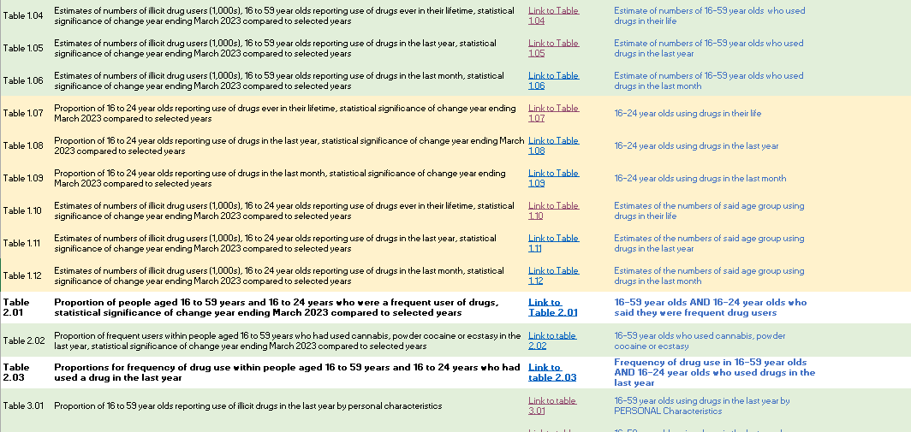

Notes:
After downloading and reviewing the dataset, I categorised and simplified the contents for a better understanding.

Slide 6

Scrubbing
Remove [x] values
Extract relevant data → Pivot table or regular tables → Pivot Chart/ Charts
Notes:
Next, the scrubbing. The dataset presented a lot of x values which had to be removed as they represented data that is not available. I removed irrelevant data and extracted necessary information to create meaningful charts via Pivot Analysis

Slide 7

Data Set details
16-59 year olds, ad 16-24 year olds
January 1995 to March 2023
Reported using drugs in their life, in the last year and in the last month
Personal characteristics, Household area characteristics, Source of drugs, prevalence of use, ease of obtaining drugs etc
22 types of drugs, with a summary row of Class A type drugs and All drugs.
Notes:
The dataset mainly covers the 16-59 age group, with a focus on 16-24-year-olds, from January 1995 to March 2023. It records drug use over a lifetime, the past year, and the past month, across 22 different drugs and various personal and household characteristics.

Slide 8

Questions to ask
Does the younger generation use drugs more frequently than the older generation?
What difference does Personal Characteristics make to drug use?
What difference does Household and area characteristics make to drug use?

Slide 9
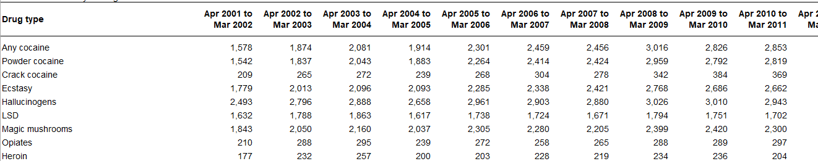

Data Dictionary
Column Name | Data Type | Description
Drug Type | String | Different types of drugs as recorded by the survey
[Date] | Integer | Statistical significance recorded
Notes:
Before we move onto the analysis, lets take a quick look at the Data Dictionary. Now the data set comprises of 34 tables, with a similar layout as shown. The Drug Type is a string or text as it would simply state the name of the drug. The Columns would comprise of different dates, approximately with a year length, with values representing the statistical significance according to the unweighted base number of people.

Slide 10
